Slide 1
NATURAL GAS VEHICLES
A “STARTER” STRATEGY FOR
RURAL WESTERN TENNESSEE
Paul F. Rice, Clean Fuels of W Tennessee
(731)298-6447 mrpfrice@aeneas.net

Slide 2
THE STRATEGY
-Make it easy for local governments to deploy highly visible NGVs and to generate interest among the general public. The NGVs will demonstrate the cost savings of Compressed Natural Gas (CNG).
-The usual course for a local government or utility is to acquire a few natural gas vehicles- typically light duty pick-up trucks- for a demonstration project. This strategy simply adopts this reality by promoting modular fueling stations that can increase output as needed to fuel more and more vehicles.
-Once demand for CNG has grown to the point that private enterprise is attracted to the area to operate fueling stations, local governments fueling at their garage will be encouraged to start fueling at the private sector locations to help them with their cash flow and support the jobs created (the fleets will still be saving money over petroleum).
-The goal is not to create a network of public sector fuel retailers, but rather, a new, tax-paying, private sector fueling industry.

Slide 3
FUELING FACILITIES/TENNESSEE OPTIONS
For a starter station meeting the needs of 1 to 10 light duty vehicles, I suggest that you will need a compression rate of about 10 to 30 SCFM (stan cu ft per minute).
The fueling station vendors on the following slide are Tennessee home-grown companies offering the right mix of price, output capacity, and durability needed by local governments.
All have systems that consist of a compressor suitable for time filling a few vehicles at night, with the ability to add storage vessels to enable fast filling; by adding additional compression and storage, the fueling station gains redundancy and its output can grow with demand as new NGVs come online:

Slide 4
FUELING FACILITIES/ OPTIONS, con’t
Bob Patterson of Knoxville, Tennessee designs and builds stations under the name Onsite CNG, and has exclusive distribution rights to the Simpkins Energy compressor which is manufactured in Nashville, Tennessee. http://simpkinsenergy.com ph. Onsite CNG (865)256-2612
Donnie Leggett and Dwain Beydler operate as MidSouth CNGV and are Tennessee’s exclusive distributors for FuelMaker fueling units as well as CNGas fueling components; can assist with vehicle sourcing. Operations in Moscow, Tennessee. http://midsouthcngv.com/ ph. (888) 456-7483
Tri-State Meter and Regulator is Tennessee’s exclusive dealer for design, sales, installation, training, and service of the GreenLine CNG Fuel Systems for both Time-fill and Fast-fill NGV operations. Tri-State Meter, located in Memphis, has been serving the natural gas industry for many years. www.tristatemeter.com
ph. (800)365-1987

Slide 5
VEHICLES
-You can get most light duty vehicles you need from dealerships, complete with either vehicle manufacturer’s warranty or CNG system warranty; your mark up for the natural gas option will run from $9,000 to $12,000.
-Clean Fuels of W Tennessee can help you use any vehicle brand and dealership you want, and can provide consulting from your first NGV through the logical transition of most or all of your fleet.
-Also, Knapheide and Worktrux are well versed in outfitting specialty vehicles with CNG tanks and systems.

Slide 6
FINANCING
Clean Fuels can also assist you with financing of the station and the vehicles- and even a multi-year fuel contract. The Tennessee Renewable Energy and Economic Development Council (TREEDC) has developed a pooled bond program to fund capital costs relating to transitioning to compressed natural gas vehicles. According to their brochure, ‘loans will be sized to fall within existing revenue streams and will be repaid through the savings enjoyed by the borrower.’ The interest rate on this money is quoted as 1.75%; if you prefer to borrow and preserve your cash, you may reasonably tell your Board that this is too good to pass up.

Slide 7
LONG TERM, EVEN ONE NGV SAVES MONEY
Natural Gas is less expensive than gasoline.
$2.13/gge for CNG
$3.72/gal for gasoline
JEA’s Experience – ½ Ton Pick up Truck
14,400 miles/yr, 12 mpg, $11,000 nat gas option
5.5 year breakeven, $6,214 Net Present Value over 10 year life
Excludes fueling station cost
Convert diesel to CNG/gasoline
14,400 miles/yr, 12 mpg, $3,000 conversion
1 year breakeven, $21,565 Net Present Value over 10 year life
$11,000 CNG option - $7,000 diesel option = $4,000 net

Slide 8
ACTION ITEMS
Arrange a meeting with a representative of the TREEDC loan program to get the finances lined up;
Draft a Request for Bids to dealerships for the appropriate vehicles;
Draft a Request for Proposals to the station builders/suppliers;

Slide 9
West Tennessee NGVs
Small facilities already exist at Fayette/Hardeman Gas Utility District, Gibson Gas Utility District, Jackson Energy Authority, Paris/Henry County, Parsons, and MLG&W in Memphis is going full bore with 5 large public access stations.

Slide 10
WHAT IS CLEAN CITIES?
Clean Cities advances the nation's economic, environmental, and energy security by supporting local actions to reduce petroleum consumption in transportation. A national network of nearly 100 Clean Cities coalitions brings together stakeholders in the public and private sectors to deploy alternative and renewable fuels, idle-reduction measures, fuel economy improvements, and emerging transportation technologies. The program is set up under the US Department of Energy. West Tennessee’s coalition is organized as “Clean Fuels of West Tennessee”.

Slide 11
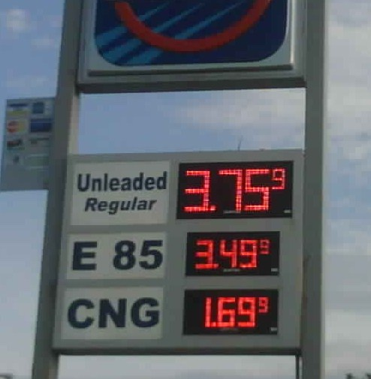
LET’S ROLL!

